Slide 1
Improving communication between a neurotypical employer and their neurodivergent employees in regards to task management
School of Computing Final Year Research Project
Ryan Edward Harris
UP938769
Notes:
My research project is to help improve the communication between neurotypical employer and neurodivergent employee in regards to task management.
What do I mean by task management?
Well, for someone with Autism, it can be very difficult to manage tasks, especially if you don’t fully understand them.
This can lead to a whole bunch of problems which I will expand upon through the slides.

Slide 2
The Problem
Communication difficulties between neurotypical (NT) and neurodivergent (ND) people.
A focus on Autism Spectrum Disorder (ASD) also referred to as Autism.
Other areas of neurodivergent differences.
A focus on the workplace.
Important for everyone.
Not enough research
Notes:
The problem I am looking at is the difficulties neurotypical and neurodivergent people have when communicating with each other.
I will be focusing mainly on Autism Spectrum Disorder as it is the neurodivergent difference that I am most familiar with and know the greatest about. However, I am not limiting it to just that and where possible I will include other neurodivergent differences.
As an aside, I am calling them neurodivergent differences rather than disabilities, difficulties or disadvantages as I feel that these words are too negative and don’t portray any neurodivergent difference in the most appropriate way.
The area of communication I am looking at is the workplace. This is because, as I am sure you are aware, communication is key in almost every workplace and therefore those that struggle with communication, like myself or others with a neurodivergent difference, are immediately at a disadvantage.
There isn’t enough research into this topic and I hope to be part of the small number of people that aim to change that.

Slide 3
Why is this worth doing?
I have experience in dealing with these struggles.
New and stressful situations can be;
Overwhelming
Too much information
Not completing tasks on time.
Not at required standards.
Task not even started.
No help.
Many autistic people close to me.
Many benefits.
Notes:
So why is this worth doing? Well, I know about these struggles that come with being neurodivergent. What they are and how they can affect people, because I live with them myself.
They can cause new and stressful situations to be overwhelming and therefore any information being given to you by a manager can just be too much to handle. (or cause an overload)
Stereotypically, employers aren’t keen on employees that can’t “handle” a situation and so the employees time at that job may be cut short if not given the chance to consolidate themselves.
All of that information and the feeling of being overwhelmed can lead to a neurodivergent individual to not complete tasks on time, or if they do then the task may not be complete to the managers standards.
In a worst case scenario, the neurodivergent employee may not even be able to start the task given to them…
This can lead to becoming more and more stressed out and overloaded and can just snowball and get worse and worse.
What doesn’t help is that the neurodivergent employee might not be able to ask for help when it comes to completing the task due to them worrying about what someone might say or perhaps they do want to ask for help, but they just can’t find the right words to explain what they need help with or why.
A quick anecdote from my life would be; I struggle to ask lecturers/teachers for help. Even if they have said to just put up your hand and they will come and help, my anxiety tends to get the better of me and I won’t do that.
For me I tend to be more comfortable in a one-to-one situation or if I have some sort of a relationship with the lecturer where they are aware of my situation.
Of course this relies on me confronting the lecturer and explaining my situation which isn’t something I am necessarily comfortable doing in front of a room of people and so it would have to wait until after the lecture/seminar.
Furthermore, I know many autistic people and most if not all of them would appreciate some kind of solution to help them with these difficulties.
Having a solution to this problem would provide many benefits, not only to a neurodivergent person, but also to the neurotypical employers as they would be able to employ anyone on the spectrum without any doubts that they can do the job.
Some of these benefits would be:
- Less overwhelming tasks
- Less stressful work environment
- Increased teamwork
- Increase in confidence for neurodivergent employees

Slide 4
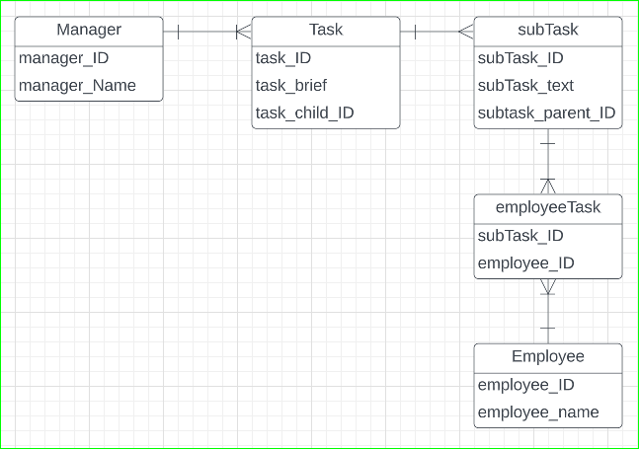
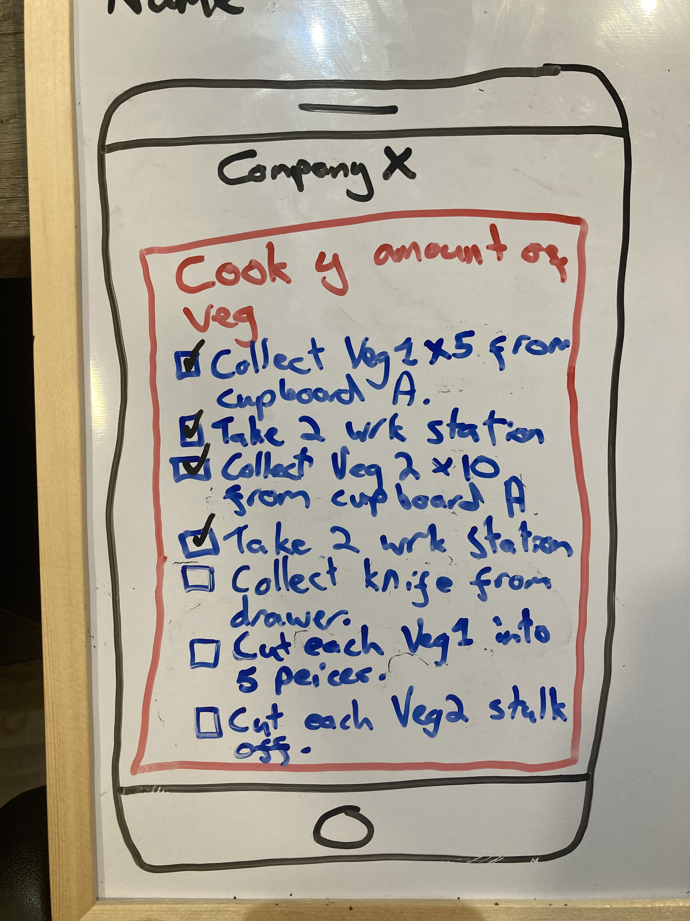
Aim
Make a start for others.
Reduce communication gap.
Create a less stressful work environment.
Solution
Why research?
Something to be built on.
Database.
Documentation.
Only part of the solution.
Notes:
What is my aim?
Well, I hope that my research can be a start for others to build on. A stepping stone of sorts.
This is because I am aware of how large a process this will be, as a whole, and how it will most likely take more time than I have to complete the project.
I hope that what I do produce would take the initiative in helping to reduce the communication gap between neurotypical and neurodivergent people in the workplace.
And finally my aim for my solution is that it would create a less stressful work environment for everyone.
Giving someone the ability to complete numerous tasks without constantly asking what they need to do next would reduce the stress in both neurotypical and neurodivergent employees.
For neurodivergent because they will feel like they are actually part of the team and for neurotypical because they can focus on their own tasks more often.
Why a research project?
I’m not trying to complete something and push it to a production level immediately by creating an app. Hence why this is a research project and not an engineering project.
I did originally feel like an engineering project would be best for me, however, after a discussion with Mark, we came to the conclusion that a research project would suit me better.
This was due to the fact that I am not confident in my coding ability outside of database design, but also because I was more interested in the affect that something like this would have on people rather than being interested in the process of making it.
This solution is something that can be taken by others and built upon. Tackling a problem such as this is going to take more than just my research and suggestions.
So, what is the solution?
A database.
Designed to be able to hold (x) amount of tasks and have those tasks split into several smaller tasks, where the Manager is the only one who can write to the database and the employee only has access to read it.
This would be through some sort of interface/app or something rather than putting queries in via a terminal.
The image shows an entity relationship diagram I made quickly to demonstrate this. As you can see, the manager is the only one who has access to creating the tasks and the employee only has access to the tasks that have been broken down into smaller, understandable sections.
As a quick note on how others could build upon this.
They could take my concepts and create the interface/app that would be required to use the database.
Or read my final report and documentation to find other ways that this problem can be solved, as we are told time after time, there is no single way to solve a problem.
For example, here is a concept I drew for what an interface could look like. I only included this as I didn’t feel like I was explaining the way that the neurodivergent employee would see things very well.
I’m not great at giving a visual description without an aid so this is my aid.
This is only part of the solution. As I stated previously. This problem is much larger than it seems and I don’t have enough time from the start of the project to the end of the project to be able to provide other viabilities.
Something to talk about if asked questions:
I am not quite sure how the tasks could be automatically broken down instead of the manager having to try to break everything down and manually entering each sub_task while making sure it still all makes sense.
The way that I imagine this to be done is that the manager only has to enter in the task they want the employee to do, the application would then take that text and some sort of algorithm would output that single task into smaller more understandable sections

Slide 5
My Approach
Progress
Future Work
Literature Review
Requirements
Database
Form/Questionnaire?
Interviews?
Report
Final Report
On track.
Lots to show.
Ready for feedback.
Lots ahead
Finish Literature Review
Database
Form/Questionnaire?
Interviews?
Report
Final Report
Knuckle Down!
Far behind…
Not much to show…
Not a lot to provide feedback on…
Health problems…
Yet to finish Literature Review…
Had a big plan…
Nervous about this presentation…
Notes:
Moving on to how I planned to approach this;
I planned that I would start by writing the Lit Rev and researching as much as I could that I felt would be relevant to the research project.
I would then try and figure out the requirements for the database and put together the ERD and data dictionary for it.
Making the database would be the next step and to do this I would use the VM provided by the university as I know I can access it anywhere I have an internet connection and that I can only lose the data on there if I drop the database…
After creating the database I planned on speaking to Mark about the next steps to take as I wasn’t really sure where to go after this.
At the beginning of the year we discussed creating a form/questionnaire and asking several people with a neurodivergent difference to answer the questions anonymously.
Mark and I discussed the last question being something like if the participant would like to be contacted for an interview.
This was to be decided when creating this form as I would need to be confident in asking all of the questions and keeping the conversation going. At the start of the year and this project, I very much was not in the position for this.
After getting all of the forms back I would write up a report on the results and include that in my final report.
Which I would then start pulling everything together to create.
So… How am I going with this approach?
Well, I’d love to stand here and tell you that I’m on track, have lots to show and that I’m ready for feedback on my progress so far…
But…
I’m actually very far behind.
I don’t really have anything to show. This presentation contains a large portion of it.
I’ve had problems with my health since the start of the year. Of which I have kept Mark as up to date as I could.
I haven’t finished my literature review yet. Which you can see… is one of the first steps…
I had this big plan that I made clear in my PID to you now during this presentation.
And honestly… I’ve been very nervous about this presentation as I know it’s a kick up the butt for those who haven’t done anything yet. But I have been working on it. I just haven’t been able to work on it very much.
I even had an entire module worth of coursework deferred to the summer period due to being so overwhelmed and unwell.
Moving to the future…
I have lots of work ahead of me.
I need to finish… well everything you see here.
From the Lit Rev to the Final report, although I wouldn’t be at the final report stage by now if I was on schedule.
If I was on schedule I would imagine I would be close to finishing the Database.
But the point is. Now I’m getting better. It’s time for me to knuckle down and get this all done!!!

Slide 6
What I’ve learnt
Problems
Research is difficult
From current research:
Obtaining and Maintaining jobs can be increasingly difficult.
Shortage of research in this area.
Part of research group with UoP
Internship Scheme.
Lots of positive experiences.
Worried about providing right level of support equally.
Other disability groups have higher employment rate.
A guide for managers (suggestion).
Relevant information
Takes me a while to get through it
Overanalysing
Health issues…
Notes:
From what I’ve done so far, I have learned that:
Research is difficult… and time consuming.
From my current research I have learnt:
For people with Autism, it is even more difficult to obtain and maintain a stable job.
There isn’t very much research in this area.
I am going through everything I can find with a fine comb to make sure I can get everything I can out of it due to this.
I am part of a research team with the university outside of my studies that aims to support autistic students at university right from when they make the move to university throughout.
One of the article’s I have found talks about autistic and non-autistic individuals participating in a corporate internship scheme.
In this article there have been a lot of positive experiences from both sides. – Which is great.
However, the managers still felt worried about providing the right level of support equally across their team(s).
While they were unsure of this, the managers did say that the experience with the autistic interns made them better managers. Which is great again.
But the article states there is still more work needed to make sure autistic interns are integrated alongside their non-autistic peers.
Fewer autistic people are employed compared to people from other disability groups. I don’t have more to say on that as I haven’t gotten that far into the article (16 pages).
The article also suggests that one way to improve the integration of autistic interns with non-autistic interns is to create a guide for managers. Again, I need to delve deeper into this article for more information on this.
I slightly mentioned this on the previous slide but the problems I have run into are;
Trying to find the relevant information.
As I am having to take in so much I have to take breaks to make sure I understood everything that I read so that I know if it is relevant to the topic I am looking at.
Therefore, there is so much for me to go through (in terms of time at least) that it is going to take me longer than the average person.
Lastly, as I mentioned, the big problem I’ve had is my health issues.
Not having the energy to stay awake all day and then sleeping way too much meant that I couldn’t keep a stable sleep schedule and my energy levels would fluctuate frequently.
I was trying everything I could to sort this problem out but I’ve only just started to recover really…
Can build on other disability groups being more employable
In both the Lit Rev and here

Slide 7
Questions?

